Slide 1
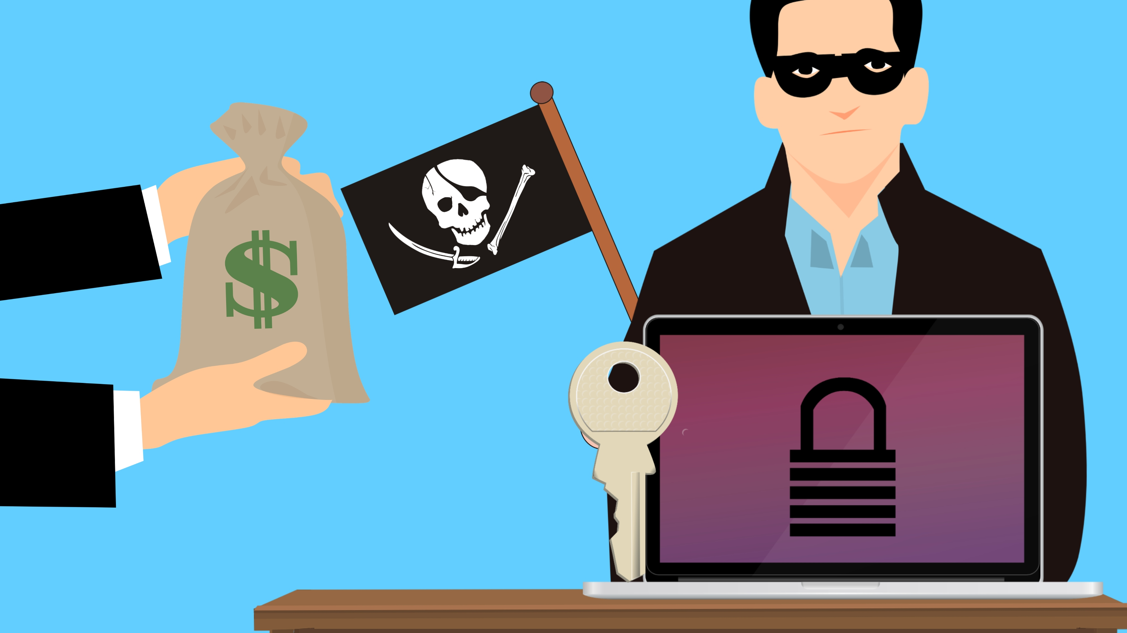
Ransomware Attack
Fahad Waheed 20i0651

Slide 2
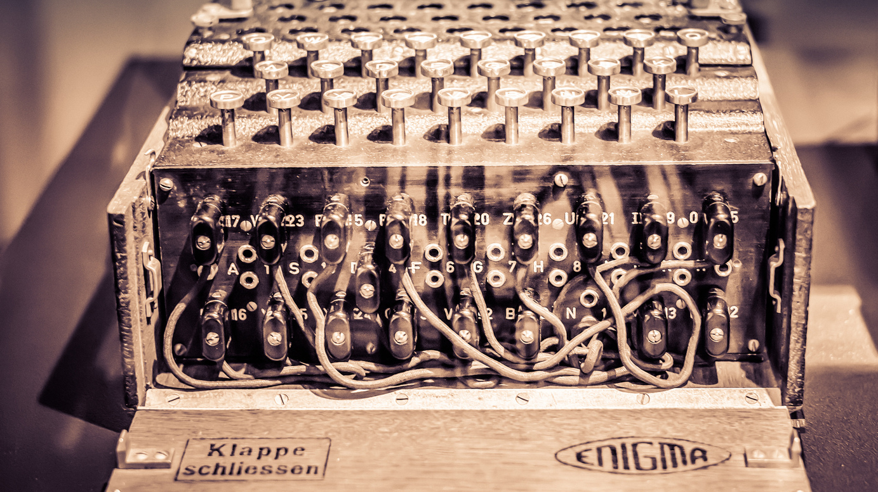
Encryption Modules used in the Project
Algorithms used for Encryption/Decryption
RSA
FERNET (AES –cbc mode)
This Photo by Unknown author is licensed under CC BY-ND.

Slide 3

Workflow
Key generation
Payload creation
Implementation

Slide 4
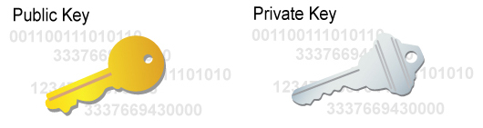
Key Generation
We have generated two keys using the RSA algorithm:
Public key(Attacker)
Private key(Attacker)

Slide 5
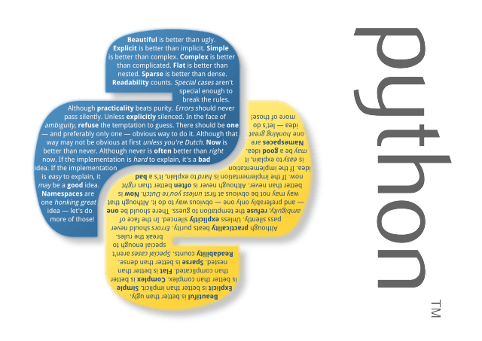
Payload creation
The encryptor code is packed with a YouTube downloader application whose code is written in the same language as the encryptor code(Python).
The payload is then sent to the victim.

Slide 6

Implementation
When the user runs the payload on his machine, a Powershell script(signed) runs that kills the Windows Defender.
Youtube downloader starts while the encryptor code executes itself in the background.
A fernet key is generated in the encryptor code and data with specified extensions on the user machine is encrypted using that fernet key.
The desktop background is then changed with a specific one and the browser opens a link.
Notepad prompts on the user screen with a ransom message. Even if the user tries to close the notepad it will open again in 10s and that’s really annoying.

Slide 7
Implementation cont.
The fernet key is then encrypted using the public key(that was generated on attacker machine using RSA) and is stored separately in a text file on the victim’s desktop.
A ransom message on the victim's screen brags, asks for ransom and provides the user about how to contact the attacker for decrypting the data.
If the victim fulfills all the demands of the attacker, the attacker then asks the victim to send him the txt file on the desktop with the encrypted fernet key.
The fernet key is then decrypted using the private key(Attacker).
The Decryptor application is then sent to the victim and the user runs the Decryptor code to decrypt his file and all the files are decrypted but that’s where the trouble begins.

Slide 8
Implementation cont.
The Decryptor application itself is malicious and contains a keylogger as the victim himself executes the application the keylogger is installed on the victim machine and is added to the startup.
The keylogger runs in the background (sending data over the SMTP protocol).
If the user unexpectedly runs the decryptor application more than once it will not affect the data on victim machine.

Slide 9
Analysis (Strengths)
We have implemented proper checks and have made sure that an encrypted file will not be encrypted again if the victim runs the program again.
Our decryption algorithm is as strong as our encryption (no data is lost during encryption/decryption process).
We have made sure that the user is able to operate the system to some extent even though the system is under ransomware attack.

Slide 10
Analysis (Strengths) cont.
All strings(keys) in our program are salted using built in functions. So, simple malware analysis won’t help.
We have made sure that the windows defender doesn’t interrupt the execution of the payload because we have made sure it is killed at the start of program execution with the help of a digitally signed shell script.
Shell script source:
Oxt0Pu5#1299
(Discord id of malware analyst)

Slide 11
Analysis (Weaknesses)
Any latest antivirus can easily identify our program as it encrypting files (major red flag). However, it can be delayed by using simple timeout and encrypting the source code with substitution cipher like morse code, but implementing it is beyond the scope of our project.
If the user tampers with the encrypted key ‘EMAIL_ME.txt’ or tries to do anything with this file. In that case, the user might lose his data.

Slide 12

Any Question?

